Slide 1
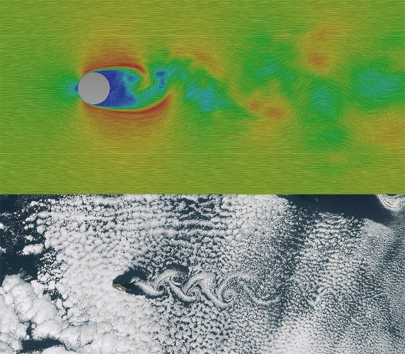
Application of Deep Learning to Computational Fluid Dynamics
Author: Jie Tao
Advisor: Dr. Greg Wolffe

Slide 2
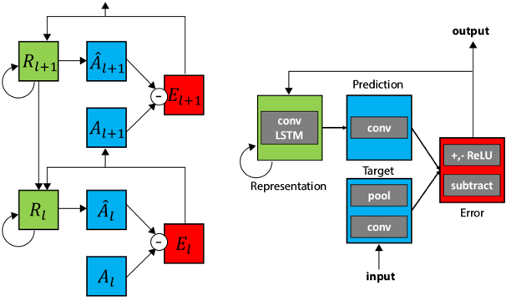
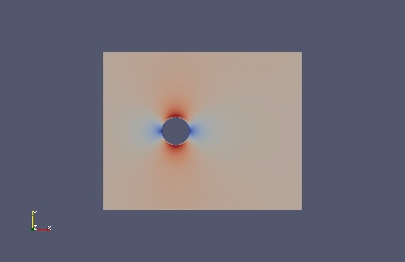
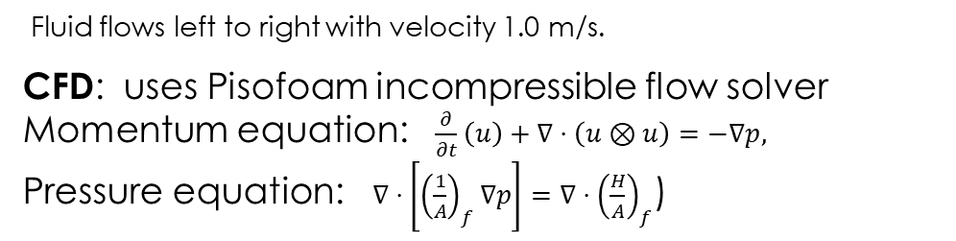
Background & Approach
1
3
Can we predict fluid flow using Deep Learning?
Similar to video
Time-based series
Spatial
2
PredNet: ConvLSTM and Encoder-
Decoder model for video prediction
ConvLSTM: multi-dimensional data,
convolutional operations at each gate
Fluid flows left to right with velocity 1.0 m/s.
CFD: uses Pisofoam incompressible flow solver
Momentum equation: $\frac{∂}{∂t}\left(u\right)+∇⋅\left(u⊗u\right)=−∇p,$
Pressure equation: $∇⋅\left[{\left(\frac{1}{A}\right)}_{f}∇p\right]=∇⋅{\left(\frac{H}{A}\right)}_{f}$)

Slide 3
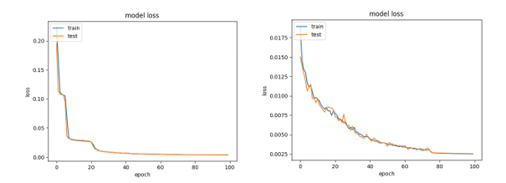
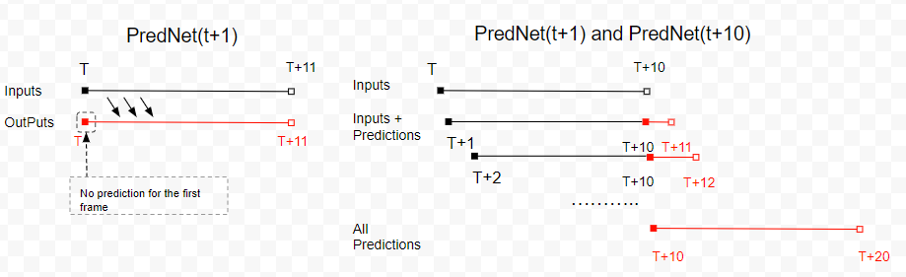
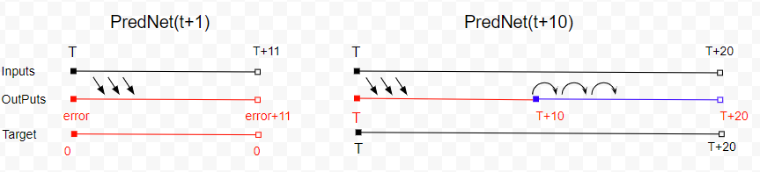
Implementation
6
4
Training and Validation Loss:
Item | Specs
HPC Name: | Ghost
Processor | AMD Ryzen ThreadRipper 16-core liquid-cooled CPU
Memory | 64GB DDR4 3200MHz Corsair RAM
Hard Drive | 1 TB Samsung SSD; 2 TB Seagate HDD
GPU | NVIDIA Titan V w/5120 cores (640 TensorCores) 12 GB GDDR5
OS | Ubuntu 18.04 LTS
Software | Keras (TensorFlow GPU), Python 3.6.7
Performance:
100 epochs, 7million parameters
Model t+1: 23 mins
Model t+10: 101 mins
Method: used Keras/Tensorflow_GPU to train two PredNet models
7
5
Time-based Models:
t+1 prediction
t+10 prediction
Prediction Strategies:
Using two trained models

Slide 4
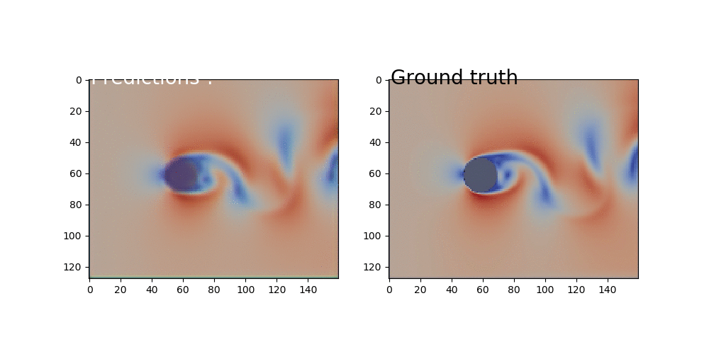
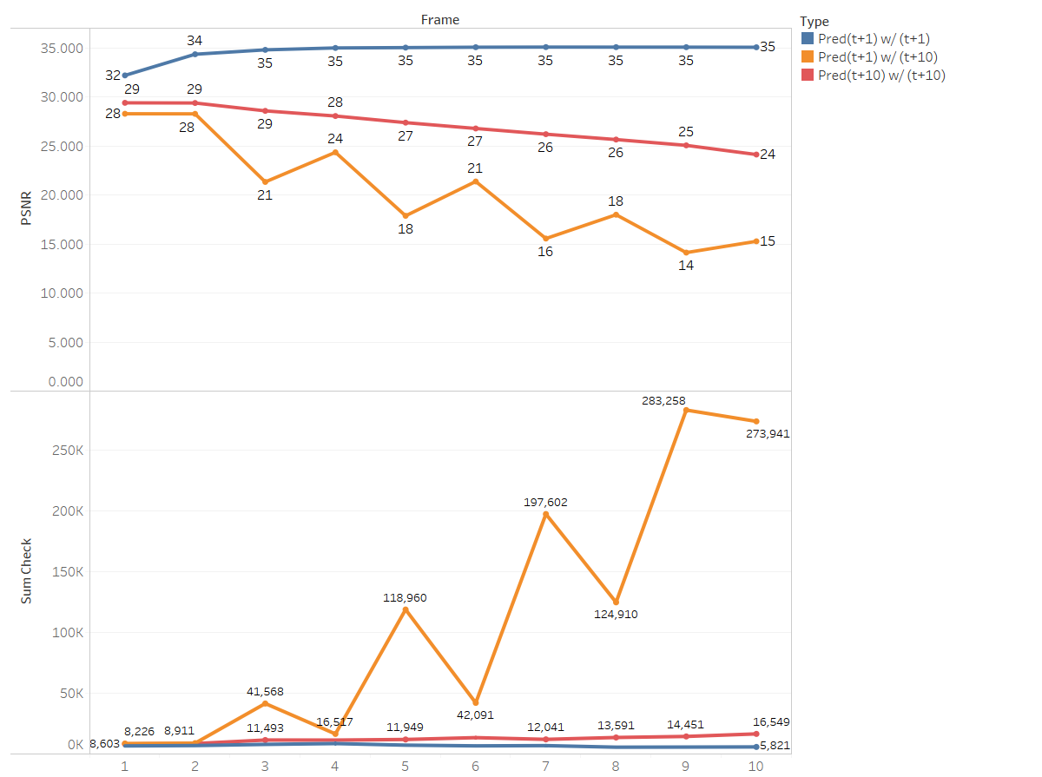
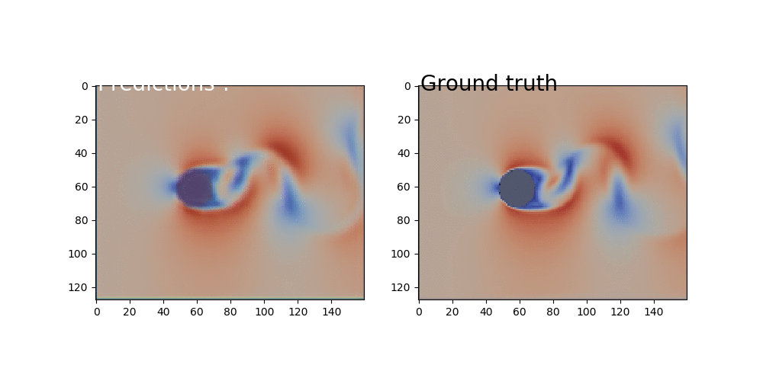
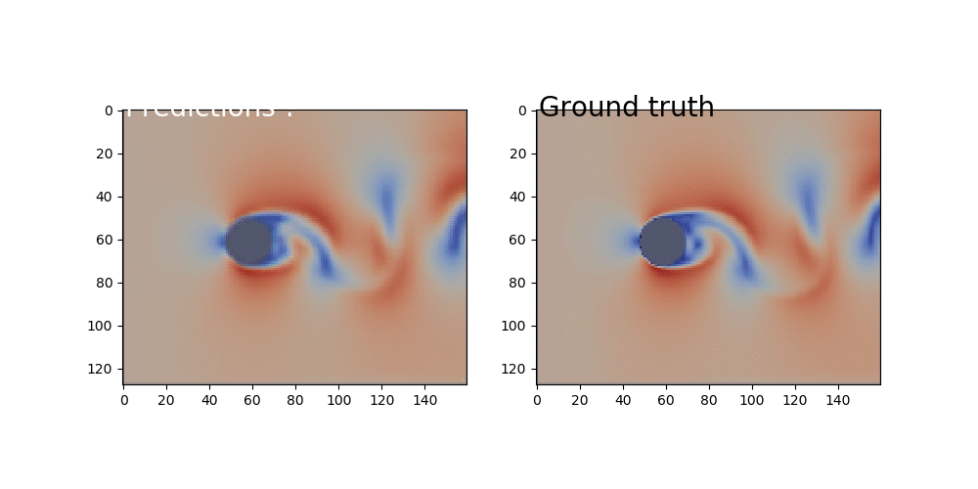
Validation & Conclusion
8
PredNet(t+1) w/(t+1)
PredNet(t+1) w/(t+10)
9
Conclusion:
DL learns to predict fluid dynamics in this restricted case
More samples needed to adapt for generalization
PredNet(t+10) w/(t+10)
Results: “extrapolation training” PredNet(t+10) for t+10 prediction

